Slide 1

Reconocimiento de Patrones
Domingo Mery
Departamento de Ciencia de la Computación
Escuela de Ingeniería
Universidad Católica de Chile
Selección de Características
[ Capítulo 3 ]

Slide 2
5 reasons why to select features
To avoid non-discriminative features
To avoid correlated features
To simplify the testing stage
To avoid false correlations
To avoid the curse of dimensionality

Slide 3
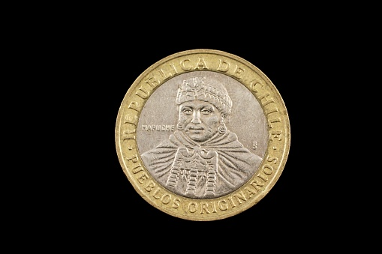
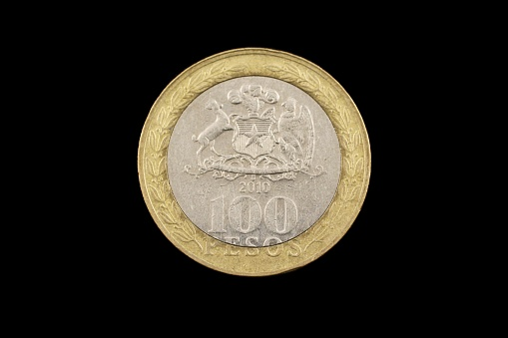

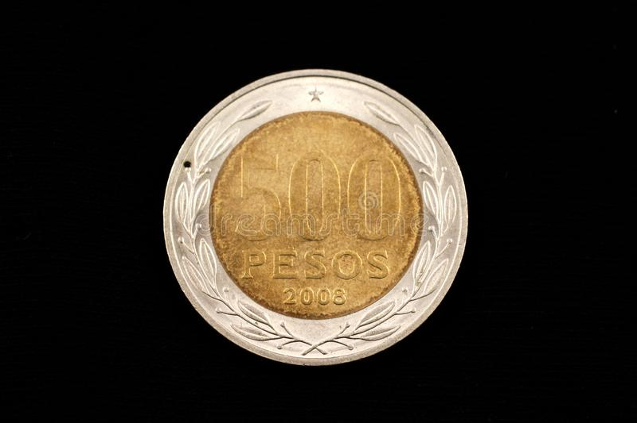


Slide 4
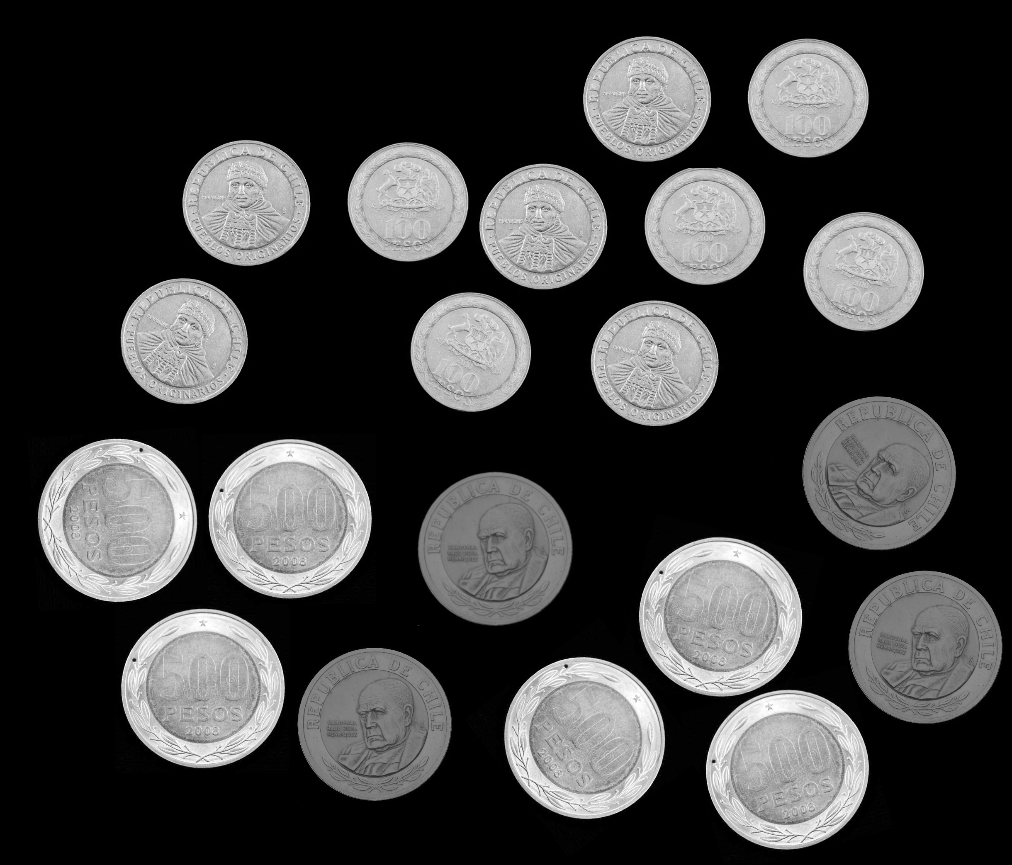
Example: Classification of Coins
A
B

Slide 5
5 reasons why to select features
To avoid non-discriminative features

Slide 6
To avoid non-discriminative features – Grayvalue average ☹

Slide 7
5 reasons why to select features
To avoid non-discriminative features
To avoid correlated features

Slide 8
2. To avoid correlated features – Area and Diameter ☹

Slide 9
5 reasons why to select features
To avoid non-discriminative features
To avoid correlated features
To simplify the testing stage

Slide 10
3. To simplify the testing stage – Area vs. Hu+Flusser

Slide 11
5 reasons why to select features
To avoid non-discriminative features
To avoid correlated features
To simplify the testing stage
To avoid false correlations

Slide 12
4. To avoid false correlations – Location ☹

Slide 13
5 reasons why to select features
To avoid non-discriminative features
To avoid correlated features
To simplify the testing stage
To avoid false correlations
To avoid the curse of dimensionality

Slide 14
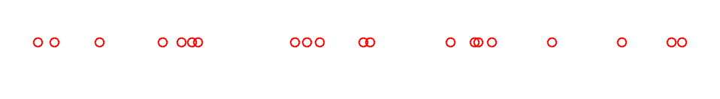
Curse of dimensionality – 1D
(20 points in 1D)

Slide 15
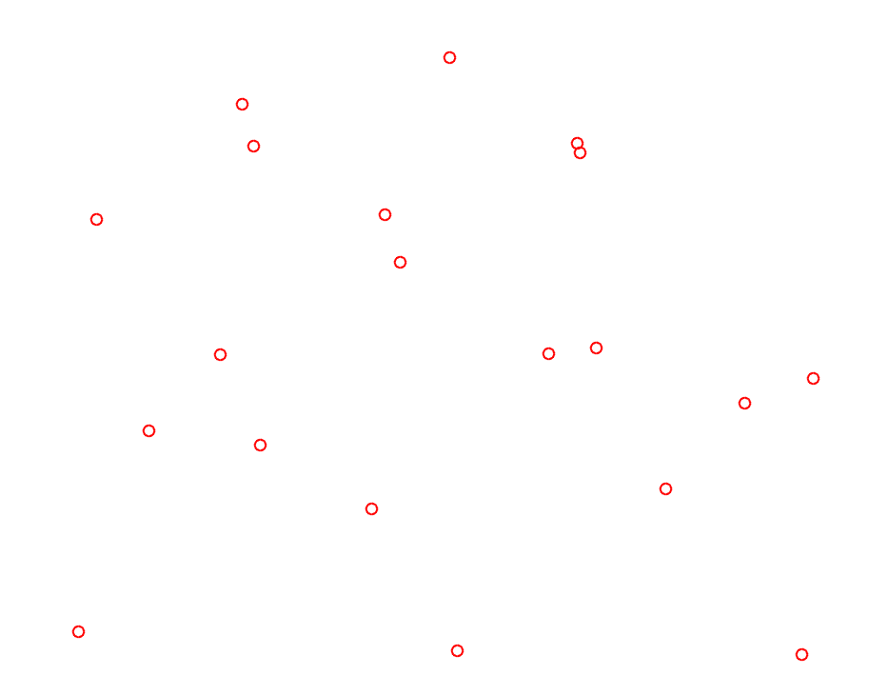
Curse of dimensionality – 2D
(20 points in 2D)

Slide 16
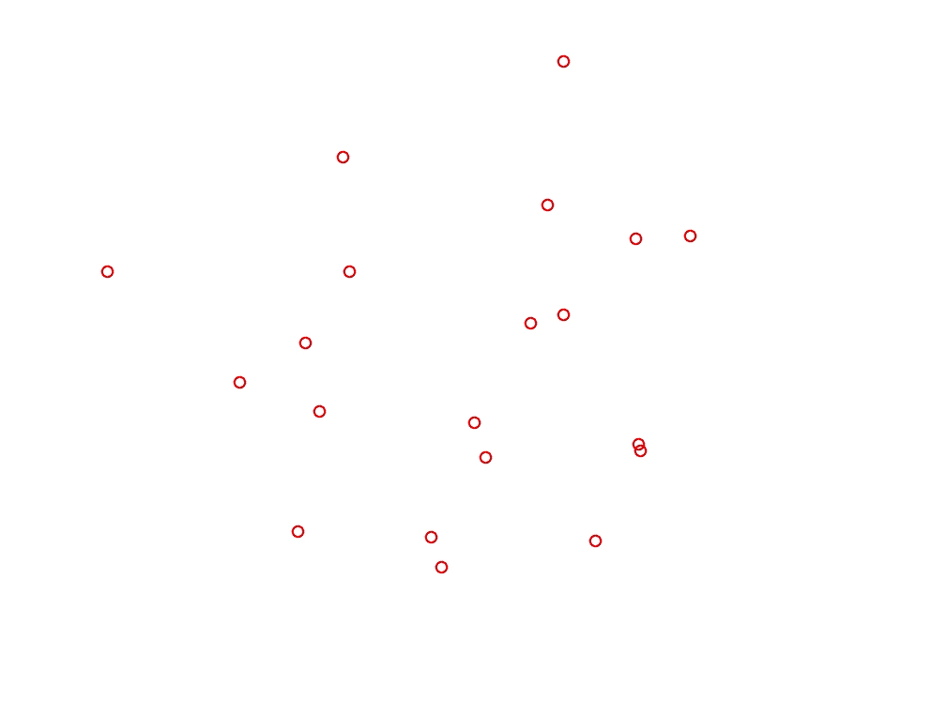
Curse of dimensionality – 3D
When the dimensionality increases, the volume of the space increases so fast that the available data become sparse. This sparsity is problematic for any method that requires statistical significance.
[Wikipedia]
(20 points in 3D)

Slide 17
Extracted features Selected features
m features
labels
p features
x₁ | x₂ | x₃ | x₄ | x₅ | x₅ | x₆ | x₇ | x₈ | x₉ | x₁₀
d
z₁ | z₂ | z₃
N samples
N samples

Slide 18
Frequency distributions
for class
Probability density functions
x
for class
x
x

Slide 19
Frequency distributions
for class
Probability density functions
…..
…..
…..
…..
…..
…..
……. . .
……. . .
x
Samples of class
for class
x
x
…..
…..
…..
…..
……..
….…….... .
Samples of class
……. . .

Slide 20
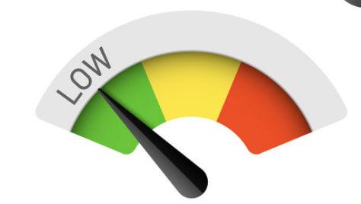


x₁
x₂
x₃
Bad separability Good separability Very good separability
score = LOW
score = MEDIUM
score = HIGH

Slide 21
Bad Good Very good
x
x
x
score = LOW
score = MEDIUM
score = HIGH

Slide 22
Bad Good Very good
…..
…..
…..
…..
……. . .
……. . .
…..
…..
…..
…..
……. . .
……. . .
x
x
x

Slide 23
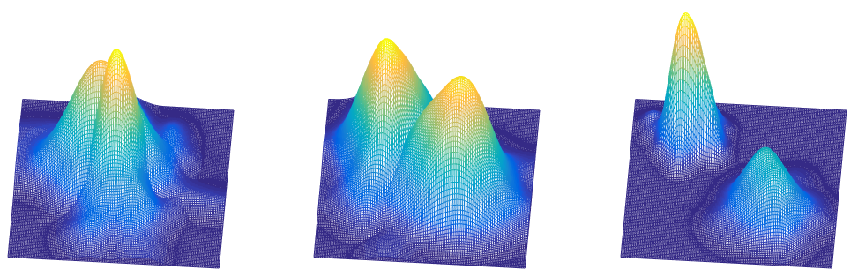
Bad Good Very good
x₂
x₂
x₂
x₁
x₁
x₁

Slide 24
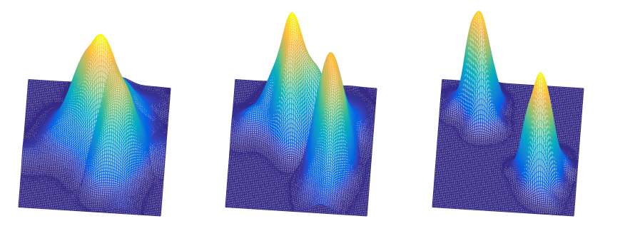
Bad Good Very good
x₂
x₂
x₂
x₁
x₁
x₁

Slide 25
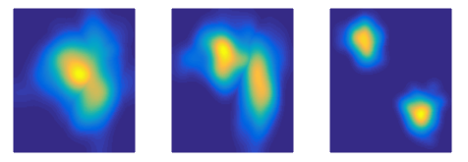
Bad Good Very good
x₂
x₂
x₂
x₁
x₁
x₁
x₂
x₂
x₂
x₁
x₁
x₁

Slide 26
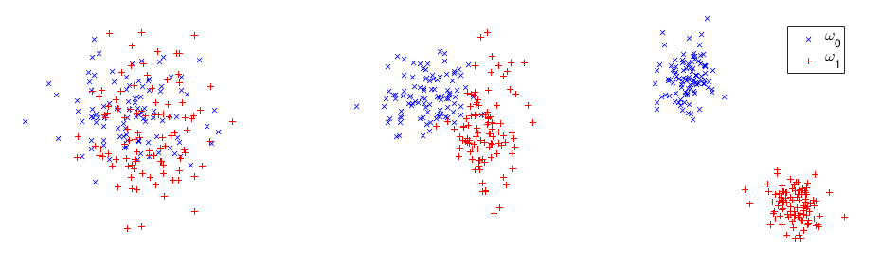
x₂
x₂
x₂
x₁
x₁
x₁
x₂
x₂
x₂
score = LOW
score = MEDIUM
score = HIGH
x₁
x₁
x₁

Slide 27
Selected features must be…
Can our objects of interest be everywhere?
yes
invariant to translation
Can our objects of interest be in any orientation?
yes
invariant to rotation
Can our objects of interest be of any size?
yes
invariant to scale

Slide 28
EJERCICIO EN SOCRATIVE - SEPARABILIDAD
No-Target
Target
x₁
x₂
x₃
x₄

